Slide 1
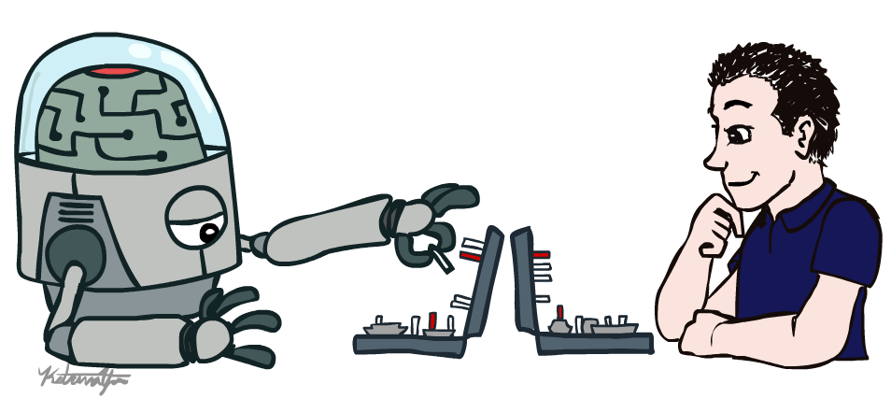
CSE 511A: Introduction to Artificial Intelligence
Introduction
Instructor: Roman Garnett
Washington University in St. Louis
[These slides were created by Dan Klein and Pieter Abbeel for CS188 Intro to AI at UC Berkeley. All materials available at http://ai.berkeley.edu.]
Notes:
Please retain proper attribution, including the reference to ai.berkeley.edu. Thanks!

Slide 2
Course Information
TAs:
Jesse Huang, Yunshen Huang
Communication:
Announcements on webpage http://cse.wustl.edu/~garnett/cse511a
Questions? Ask on piazza: https://piazza.com/wustl/fall2018/cse511a/home
Use private questions if necessary!
Course technology:
Autograded projects (unlimited submissions!) + leaderboard
Videos, etc. are also available, thanks to the generosity of CS 188 course creators at UC Berkeley!

Slide 3
Course Information
Prerequisites:
CSE 131, 240, and 247/347 (or permission of the instructor)
Knowledge of Python (you can learn as you go if you like, but that’s on you!)
Knowledge of statistics, probability, first-order logic strongly recommended!
There will be a lot of math (and programming)
Work and Grading:
4.5 programming projects: Python, groups of 1 or 2 (50% of grade)
Academic integrity policy
Due at beginning of class, can turn in projects up to one class later without penalty (but not after that!)
Exams
Midterm: in-class, Wednesday, October 10
Final: December 14
25% of grade each
Contests!

Slide 4
Exam Policy
Non-curricular activities (Job interviews, flying home early for winter break, etc.) are NOT valid reasons for missing an exam, and no special accommodation will be made!

Slide 5
Academic Integrity: Cheating vs. Not Cheating
Cheating:
You visit a homepage with solutions
You copy any code from others
Someone dictates a solution to you
Someone else writes the code for you
You pay someone else to write the code for you!

Slide 6
Academic Integrity: Cheating vs Not Cheating
Not cheating:
You work with your project partner
You talk with someone about the project
You find and use pseudocode in a book or on a webpage
If in doubt, ask!

Slide 7
Academic Integrity
Zero tolerance!
Immediate failure and referral to the Office of Academic Integrity.
In the past, people have failed, been kicked out of Wash U, and deported. So don’t do it!
Active search
Testing code for statistical similarity; renaming variable names is not going to fool us!
Other technologies.

Slide 8

Textbook
Not strictly required, but for students who want to read more, I strongly recommend
Russell & Norvig, AI: A Modern Approach, 3rd (or 2nd) Ed.
Warning: The presentation here does not necessarily follow the presentation in the book.

Slide 9
Important This Week
Register for the class on Piazza! Please ask all questions there!
Project 0: Unix/Python tutorial is out (due on Monday 9/3 at midnight).
If you are waitlisted, you might or might not get in depending on how many students drop. If you have a special need to be in the class (for example, this is your last opportunity), please contact the instructor VIA PIAZZA!
DO NOT COME TO ME AFTER CLASS FOR THIS REASON! MESSAGE ME ON PIAZZA!

Slide 10
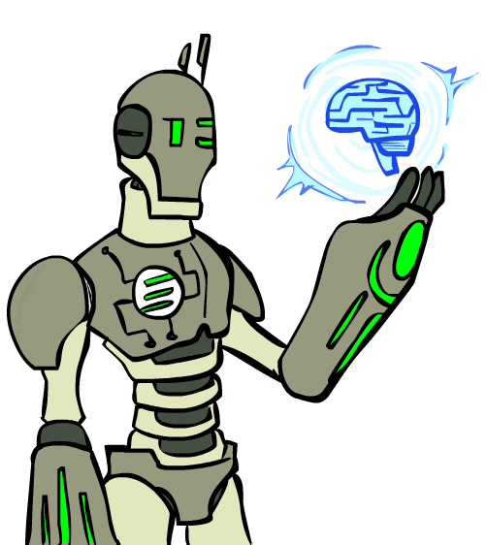
Today
What is artificial intelligence?
What can AI do?
What is this course?

Slide 11
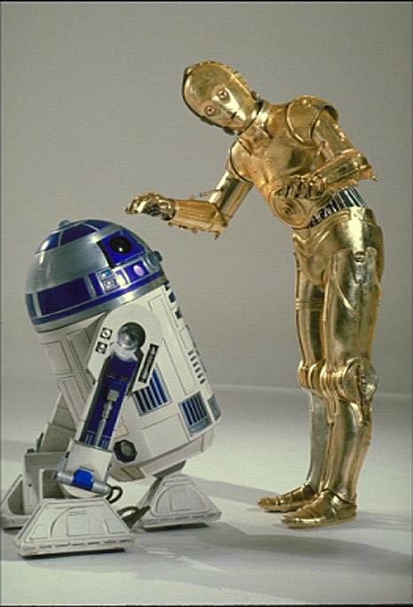
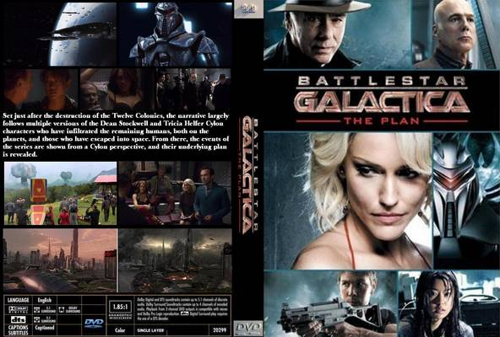
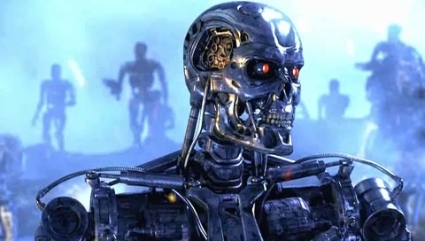
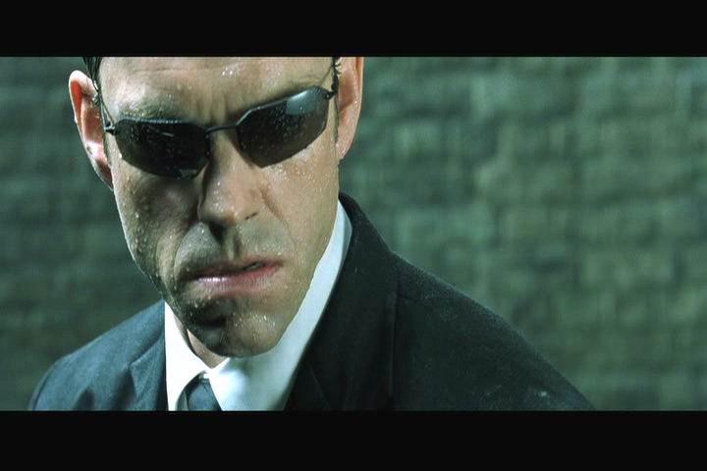
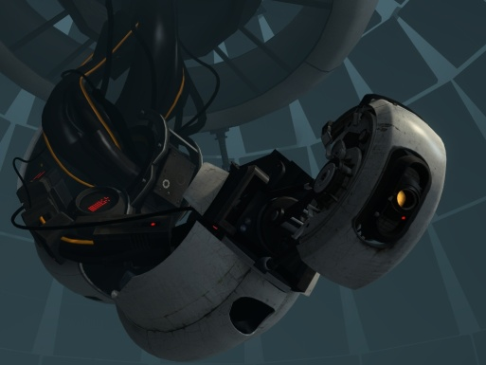
Sci-Fi AI?
Notes:
Who are these? C3PO, what does he do? Essentially google translate, (but with anxiety disorder!)
Small guy? R2D2 – what does he do, yeah, not so sure
Things got darker: machines come back from the future – to kill us!
90’s : software is scary
Basic fear about what technology might do ?
What if we can’t even tell technology apart from ourselves?
OR maybe it’ll look really different and snarky
Some exceptions like wall-E, positive view of technology (but maybe not of us humans!)
But mostly a worry
[not very worried myself, at least at present]

Slide 12
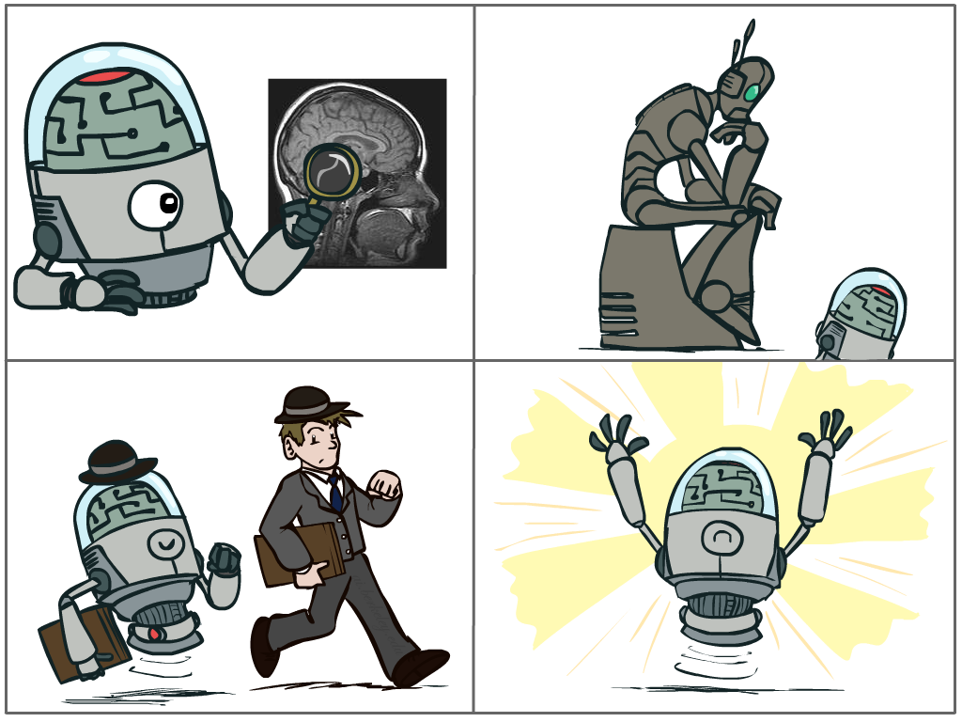
What is AI?
The science of making machines that:
Think like people
Think rationally
Act like people
Act rationally
Notes:
Top left: Think like people --- cognitive science, neuroscience
Bottom left: act like people --- actually very early definition, dating back to Alan Turing --- Turing test; problem to do really well you start focusing on things like don’t answer too quickly what the square root of 1412 is, don’t spell too well, and make sure you have a favorite movie etc. So it wasn’t really leading us to build intelligence
Think rationally – long tradition dating back to Aristotle --- but not a winner, because difficult to encode how to think, and in the end it’s not about how you think, it’s about how you end up acting

Slide 13
Rational Decisions
We’ll use the term rational in a very specific, technical way:
Rational: maximally achieving pre-defined goals
Rationality only concerns what decisions are made
(not the thought process behind them)
Goals are expressed in terms of the utility of outcomes
Being rational means maximizing your expected utility
A better title for this course would be:
Computational Rationality
Notes:
Example of utilities. 10 for A, 1 for each Friday with friends

Slide 14
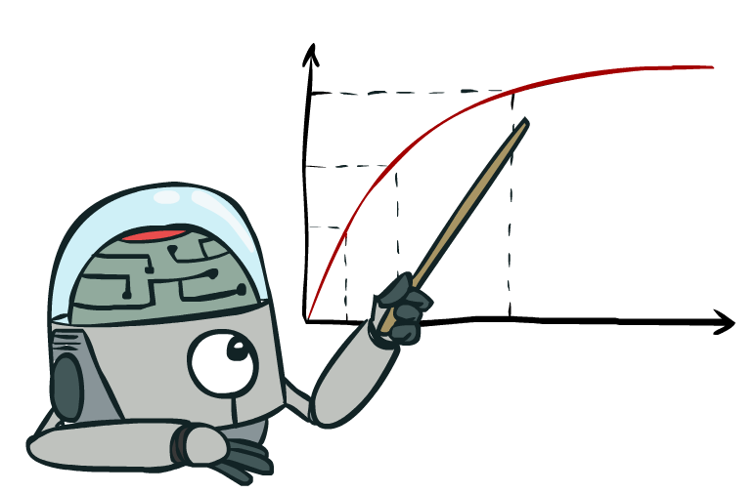
Maximize Your
Expected Utility

Slide 15
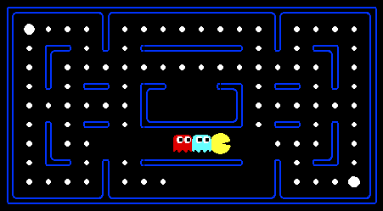
Problems with Humans
How many dots?

Slide 16
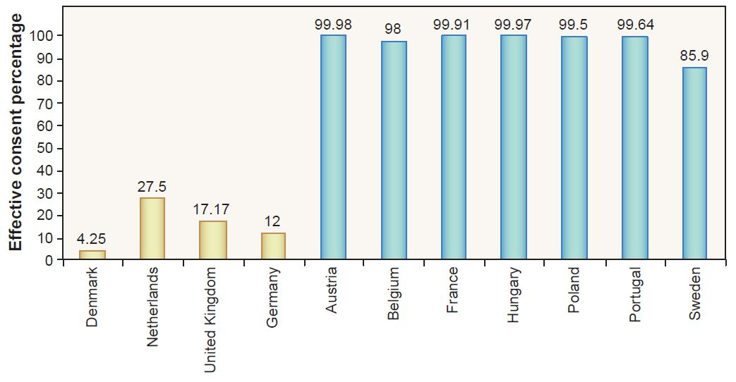
Problems with Humans: Organ Donation

Slide 17
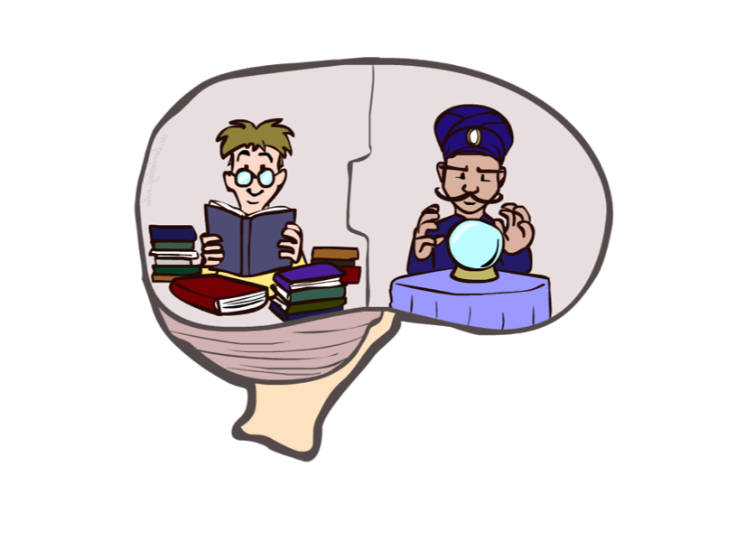
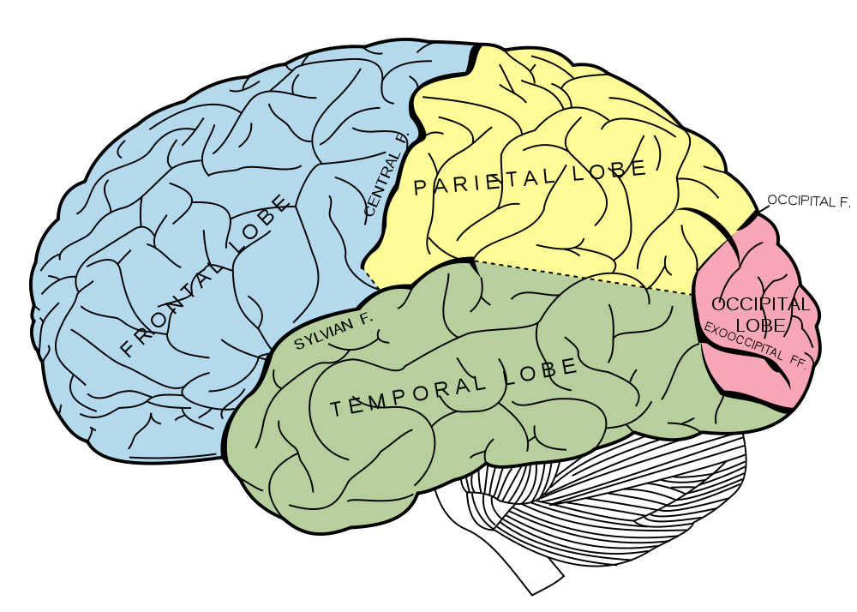
What About the Brain?
Brains (human minds) are very good at making rational decisions, but not perfect
Brains aren’t as modular as software, so hard to reverse engineer!
“Brains are to intelligence as wings are to flight”
Lessons learned from the brain: memory and simulation are key to decision making

Slide 18
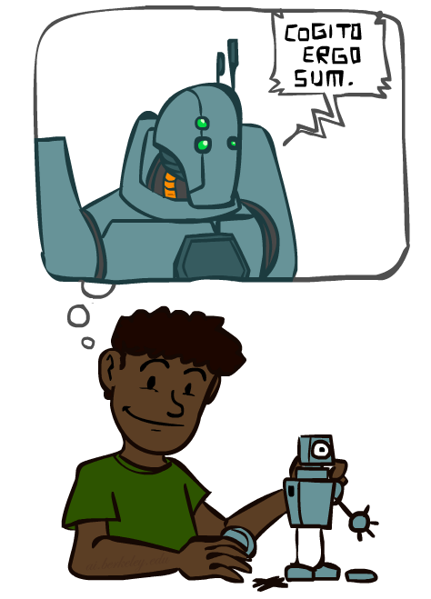
A (Short) History of AI
Demo: HISTORY – MT1950.wmv

Slide 19
Notes:
Thinking machines video --- interviews from back when computers were in the very early years; starting to realize can do something else than arithmetic ; asking where things are headed; many famous people

Slide 20
A (Short) History of AI
1940-1950: Early days
1943: McCulloch & Pitts: Boolean circuit model of brain
1950: Turing's “Computing Machinery and Intelligence”
1950—70: Excitement: Look, Ma, no hands!
1950s: Early AI programs, including Samuel's checkers program, Newell & Simon's Logic Theorist, Gelernter's Geometry Engine
1956: Dartmouth meeting: “Artificial Intelligence” adopted
1965: Robinson's complete algorithm for logical reasoning
1970—90: Knowledge-based approaches
1969—79: Early development of knowledge-based systems
1980—88: Expert systems industry booms
1988—93: Expert systems industry busts: “AI Winter”
1990—: Statistical approaches
Resurgence of probability, focus on uncertainty
General increase in technical depth
Agents and learning systems… “AI Spring”?
2000—: Where are we now?
Notes:
Million dollar computer with less computation than your phone
MT was

Slide 21
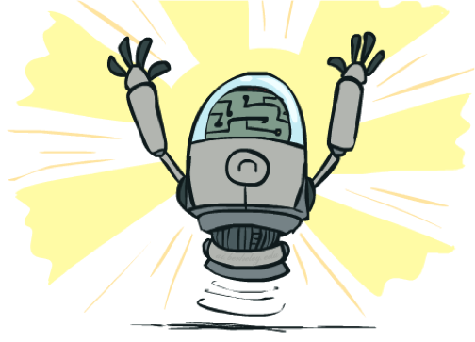
What Can AI Do?
Quiz: Which of the following can be done at present?
Play a decent game of table tennis?
Play a decent game of Jeopardy?
Drive safely along a curving mountain road?
-> Drive safely along the Loop?
Buy a week's worth of groceries on the web?
Buy a week's worth of groceries at Schnucks?
Discover and prove a new mathematical theorem?
Converse successfully with another person for an hour?
Perform a surgical operation?
Put away the dishes and fold the laundry?
Translate spoken Chinese into spoken English in real time?
Write an intentionally funny story?

Slide 22
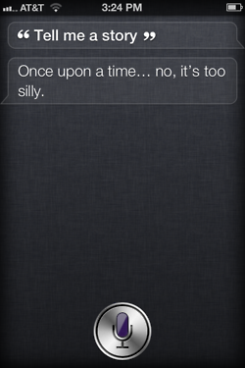
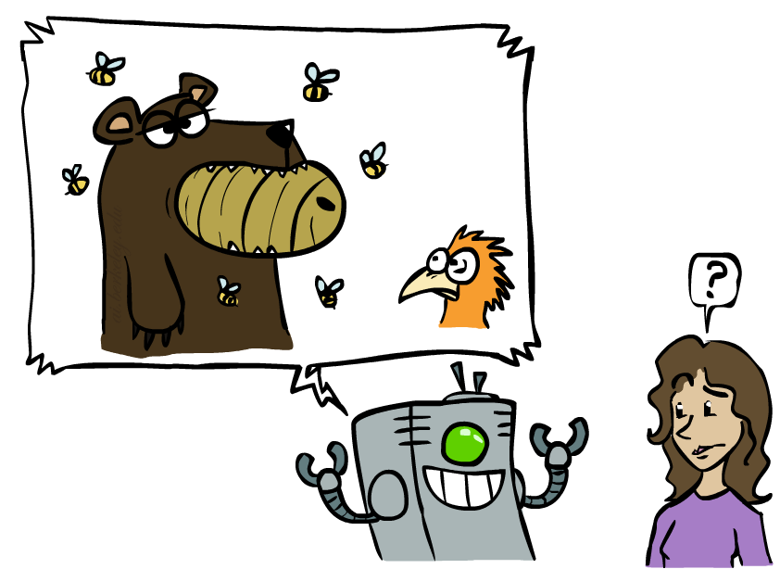
Unintentionally Funny Stories
One day Joe Bear was hungry. He asked his friend
Irving Bird where some honey was. Irving told him
there was a beehive in the oak tree. Joe walked to
the oak tree. He ate the beehive. The End.
Henry Squirrel was thirsty. He walked over to the
river bank where his good friend Bill Bird was sitting.
Henry slipped and fell in the river. Gravity drowned.
The End.
Once upon a time there was a dishonest fox and a vain crow. One day the crow was sitting in his tree, holding a piece of cheese in his mouth. He noticed that he was holding the piece of cheese. He became hungry, and swallowed the cheese. The fox walked over to the crow. The End.
[Shank, Tale-Spin System, 1984]
Notes:
1 – physically wrong, shouldn’t eat beehive
2 – forgot that in drowning not the force is most important but the drownee
3 – not physically wrong, not wrong in a language way, but wrong in the sense that it’s not aware of what is relevant to communicate and what is not
Siri – is that progress?

Slide 23
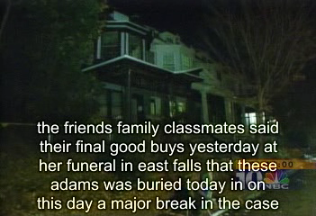
Natural Language
Speech technologies (e.g. Siri)
Automatic speech recognition (ASR)
Text-to-speech synthesis (TTS)
Dialog systems
Demo: NLP – ASR tvsample.avi
Notes:
NLP – ASR tvsample.avi

Slide 25
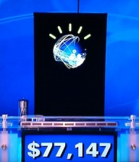
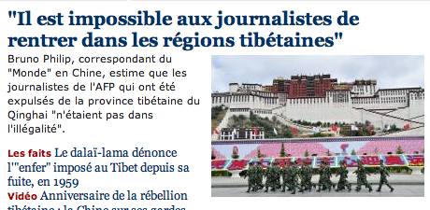
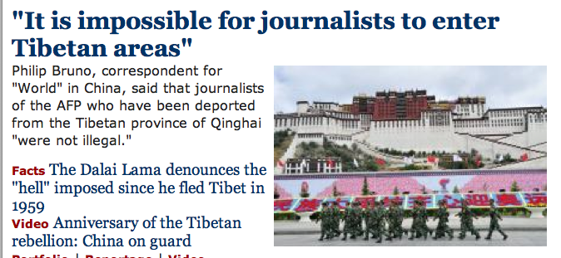
Natural Language
Speech technologies (e.g. Siri/Cortana)
Automatic speech recognition (ASR)
Text-to-speech synthesis (TTS)
Dialog systems
Language processing technologies
Question answering
Machine translation
Web search
Text classification, spam filtering, etc…

Slide 26
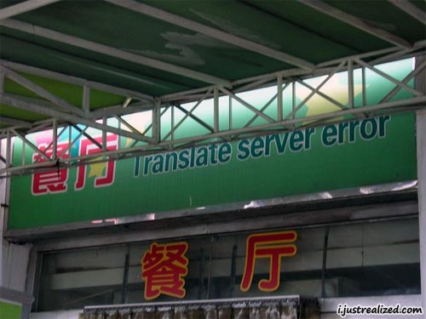
Machine Translation?

Slide 27
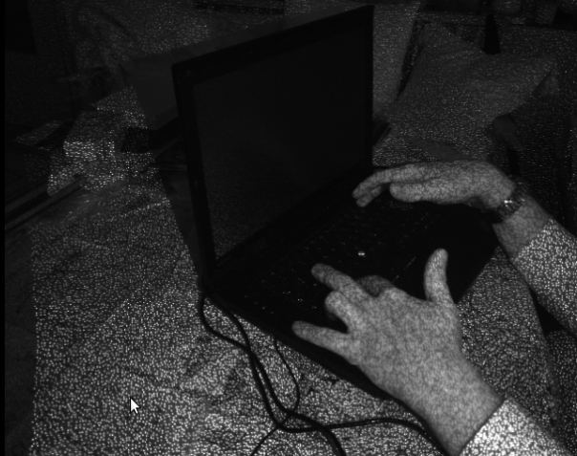
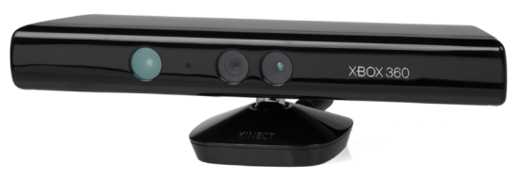
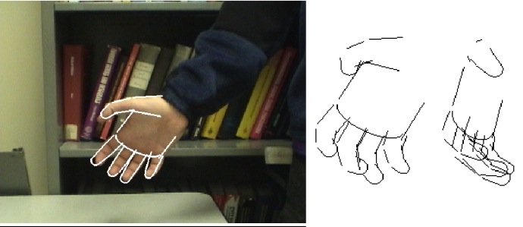
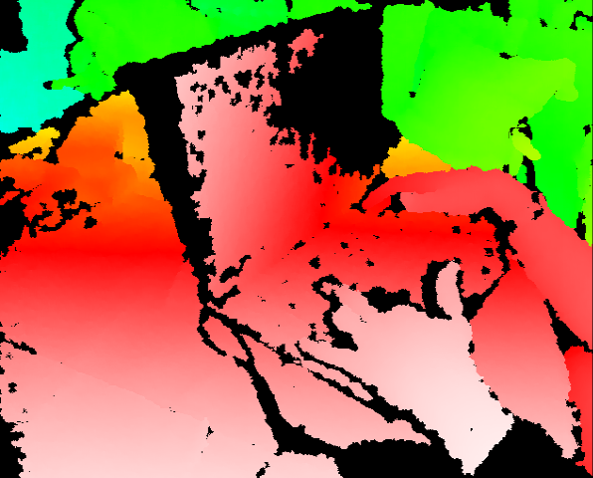
Vision (Perception)
Object and face recognition
Scene segmentation
Image classification
Demo1: VISION – lec_1_t2_video.flv
Images from Erik Sudderth (left), wikipedia (right)
Demo2: VISION – lec_1_obj_rec_0.mpg

Slide 30
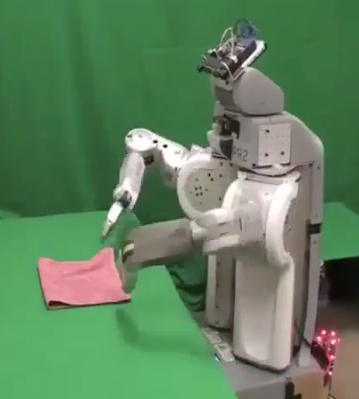
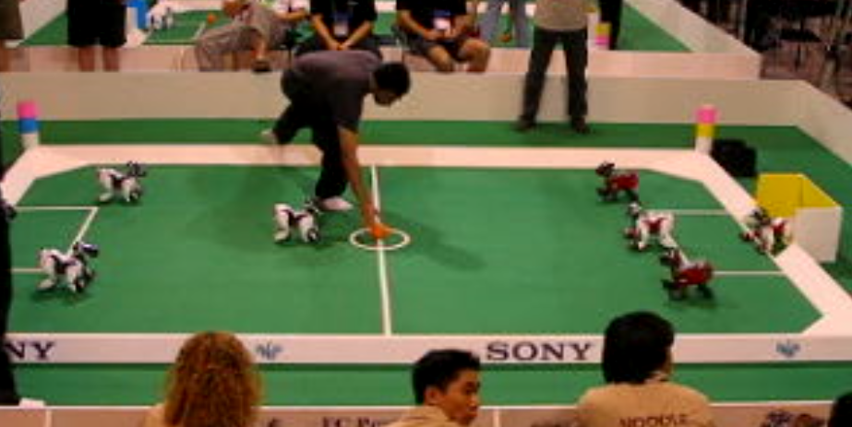
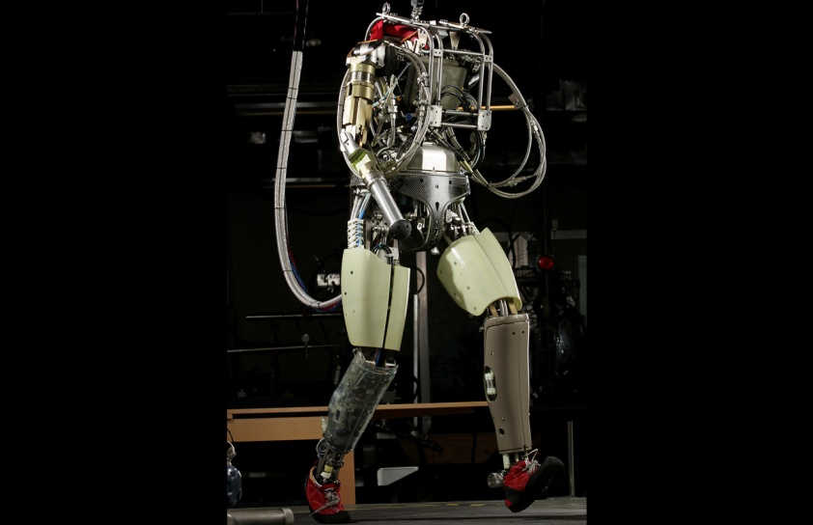
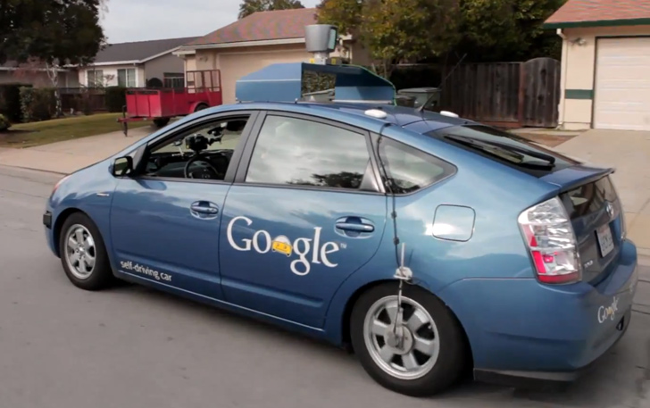
Robotics
Demo 1: ROBOTICS – soccer.avi
Demo 4: ROBOTICS – laundry.avi
Demo 2: ROBOTICS – soccer2.avi
Demo 5: ROBOTICS – petman.avi
Demo 3: ROBOTICS – gcar.avi
Robotics
Part mech. eng.
Part AI
Reality much
harder than
simulations!
Technologies
Vehicles
Rescue
Soccer!
Lots of automation…
In this class:
We ignore mechanical aspects
Methods for planning
Methods for control
Images from UC Berkeley, Boston Dynamics, RoboCup, Google

Slide 36
Logic
Logical systems
Theorem provers
NASA fault diagnosis
Question answering
Methods:
Deduction systems
Constraint satisfaction
Satisfiability solvers (huge advances!)
Image from Bart Selman

Slide 37
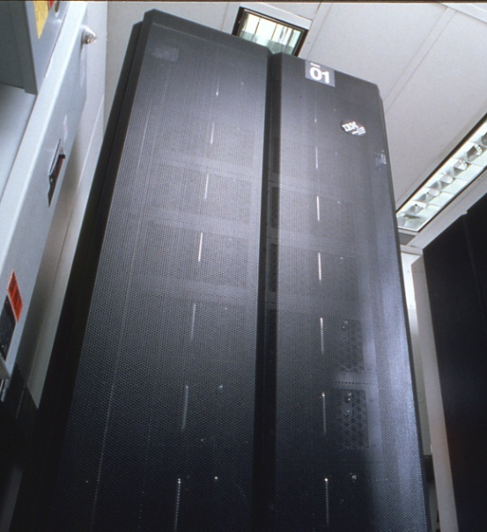
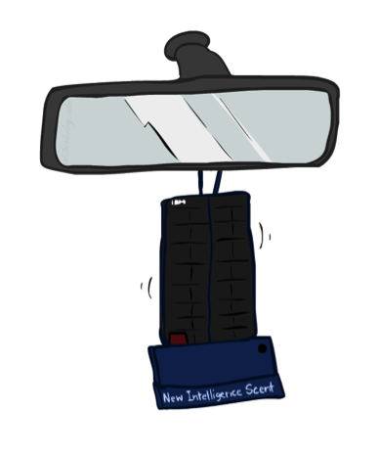
Game Playing
Classic Moment: May, '97: Deep Blue vs. Kasparov
First match won against world champion
“Intelligent creative” play
200 million board positions per second
Humans understood 99.9 of Deep Blue's moves
Can do about the same now with a PC cluster
Open question:
How does human cognition deal with the
search space explosion of chess?
Or: how can humans compete with computers at all??
1996: Kasparov Beats Deep Blue
“I could feel --- I could smell --- a new kind of intelligence across the table.”
1997: Deep Blue Beats Kasparov
“Deep Blue hasn't proven anything.”
Huge game-playing advances recently, e.g. in Go!
Text from Bart Selman, image from IBM’s Deep Blue pages
Notes:
Yeah, Kasparov comment probably says more about humans than about computers

Slide 38

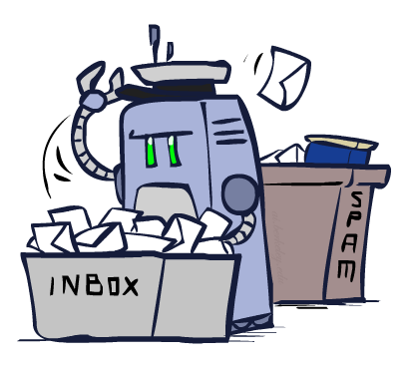
Decision Making
Applied AI involves many kinds of automation
Scheduling, e.g. airline routing, military
Route planning, e.g. Google maps
Medical diagnosis
Web search engines
Spam classifiers
Automated help desks
Fraud detection
Product recommendations
… Lots more!
Notes:
All applications can be thought of as decision making or useful sub-components of decision making

Slide 39
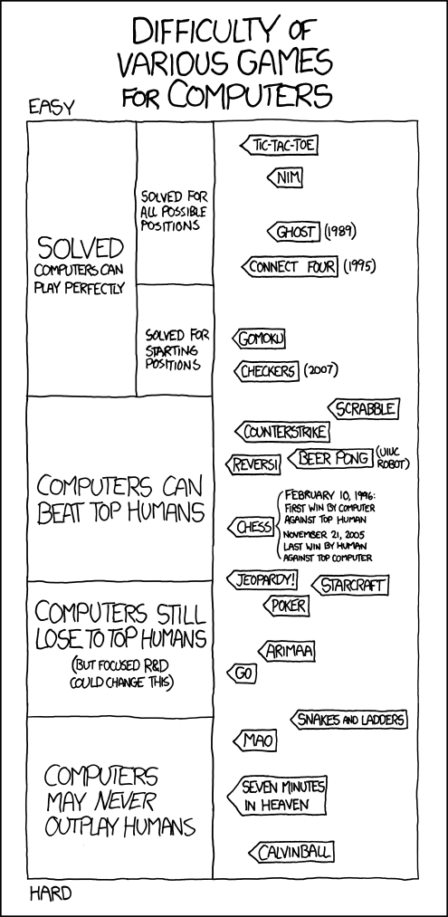
Game Playing

Slide 40
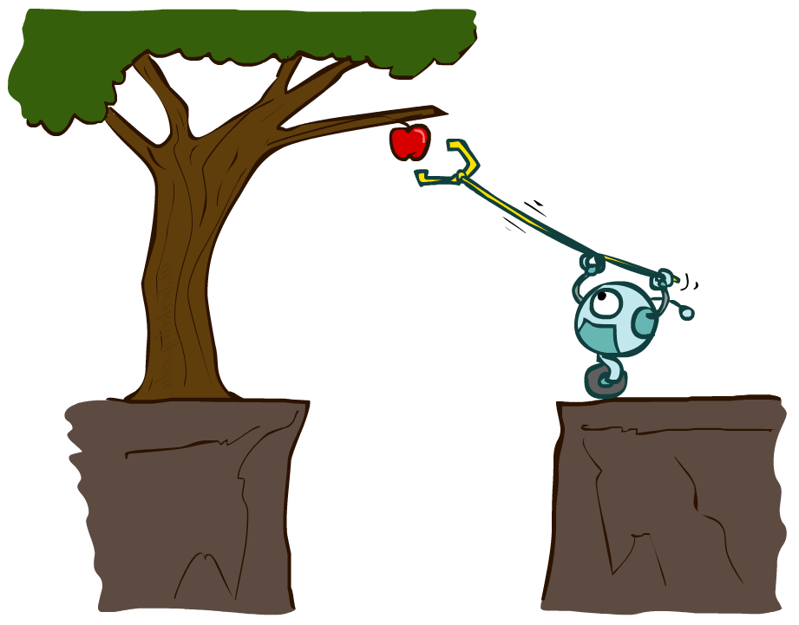
Designing Rational Agents
An agent is an entity that perceives and acts.
A rational agent selects actions that maximize its (expected) utility.
Characteristics of the percepts, environment, and action space dictate techniques for selecting rational actions
This course is about:
General AI techniques for a variety of problem types
Learning to recognize when and how a new problem can be solved with an existing technique
Sensors
Agent
Percepts
Environment
?
Actuators
Actions

Slide 41
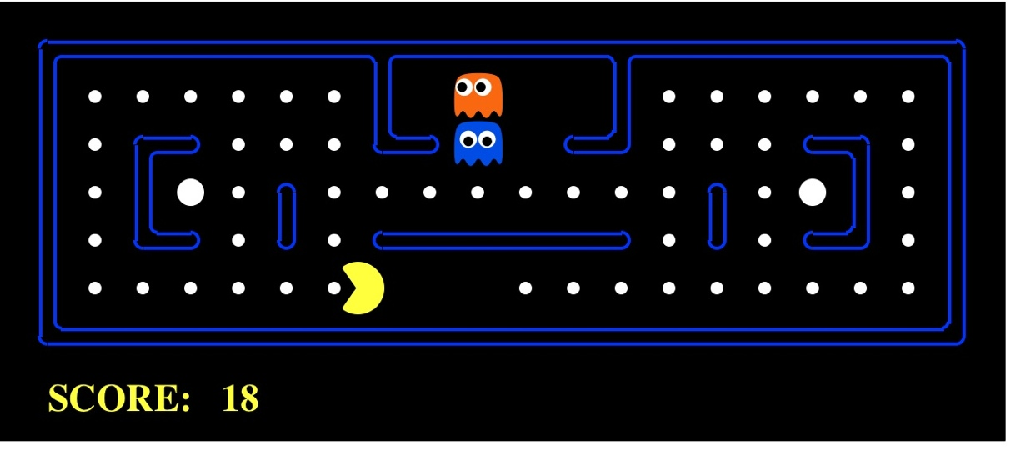
Pac-Man as an Agent
Agent
Environment
Sensors
Percepts
?
Actuators
Actions
Pac-Man is a registered trademark of Namco-Bandai Games, used here for educational purposes
Demo1: pacman-l1.mp4 or L1D2
Notes:
L1D2 =
python demos.py
Select Lecture 1 → select demo 2

Slide 42
Course Topics
Part I: Making Decisions
Fast search / planning
Constraint satisfaction
Adversarial and uncertain search
Part II: Reasoning under Uncertainty
Bayes’ nets
Decision theory
Machine learning
Throughout: Applications
Natural language, vision, robotics, games, …

